Slide 1

The Machine Learning Process
How do I handle missing values
in pandas?
Dr. Reza Dibaj

Slide 2
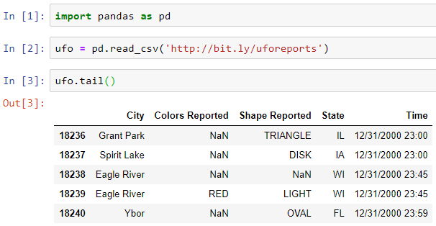

How do I handle missing values in pandas?
Let’s pull up an example dataset as follows:
What is new in this slide? And what does it do?
Notes:
import pandas as pd
ufo = pd.read_csv('http://bit.ly/uforeports’)
ufo.tail()

Slide 3
How do I handle missing values in pandas?
What is NaN in the Colors Reported column?
Notes:
It means a missing value....
When building a DF, read_csv() detected what it thought was a missing value and it flagged it with NaN.

Slide 4
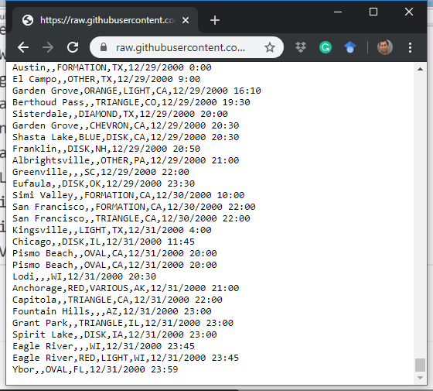
How do I handle missing values in pandas?
The source file is as follows:
The last 5 rows
Notes:
http://bit.ly/uforeports

Slide 5

Group Discussion
Please spend a few minutes with your team members and explain why some fields could take NaN value.

Slide 6
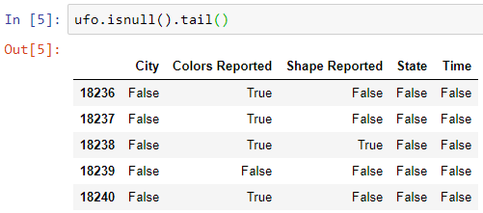
How do I handle missing values in pandas?
Learning some methods for working with missing values… The first method, which is a DF method is isnull().
It shows true when something is missing and shows false when the field is not null.
Notes:
ufo.isnull().tail()

Slide 7
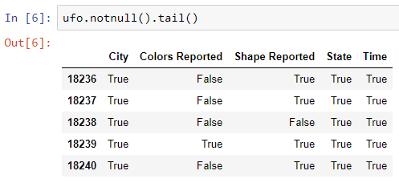
How do I handle missing values in pandas?
You can guess the notnull() functionality… right?
Notes:
ufo.notnull().tail()

Slide 8
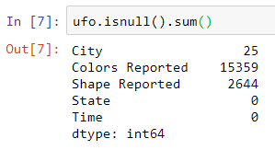
How do I handle missing values in pandas?
What does the following command do?
And how does it work under the hood?
Notes:
ufo.isnull().sum()
#It shows the number of missing values in each column.

Slide 9
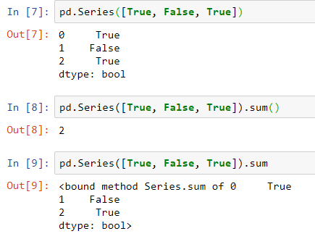
How do I handle missing values in pandas?
What does the following command do?
Notes:
pd.Series([True, False, True])
pd.Series([True, False, True]).sum()
pd.Series([True, False, True]).sum

Slide 10
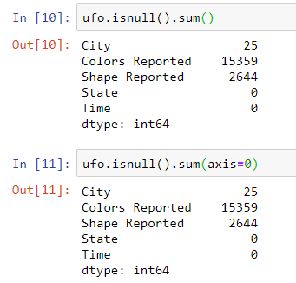
How do I handle missing values in pandas?
And why calculating the null values based on the Series?
That is how we realize where our missing values are.
Notes:
ufo.isnull().sum()
ufo.isnull().sum(axis=0)

Slide 11
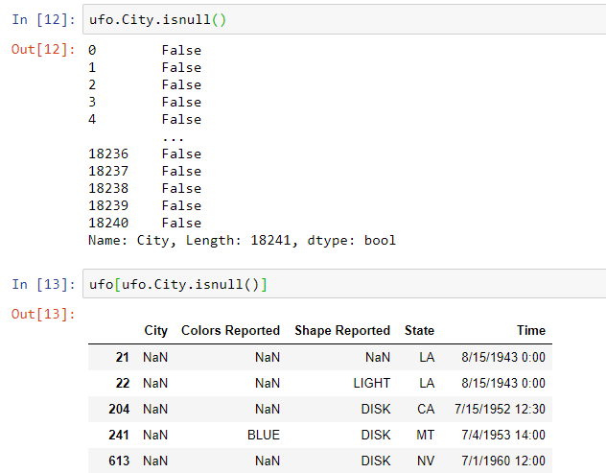
How do I handle missing values in pandas?
isnull() is a Series method too.
25 cities with null value
Notes:
ufo.City.isnull()
ufo[ufo.City.isnull()]

Slide 12
Group Discussion
Please spend a few minutes with your team members and discuss what we can do about missing values in a dataset.
Notes:
It depends on the dataset
The problem that we try to solve
One common solution: Drop the missing values

Slide 13
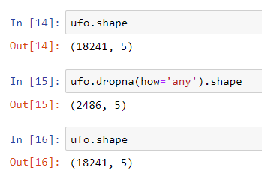
How do I handle missing values in pandas?
What we can do about the missing values….
I want to drop a row if any of its values is missing.
There are only 2486 out of 18241 rows that have no missing value.
Notes:
ufo.shape
ufo.dropna(how='any').shape

Slide 14
Group Discussion
Please spend a few minutes with your team members and discuss how we can make the drop happens permanently.

Slide 15
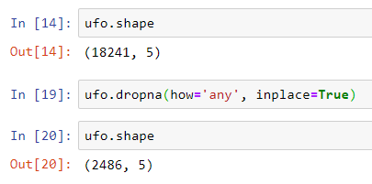
How do I handle missing values in pandas?
What we can do about the missing values….
Notes:
ufo.shape
ufo.dropna(how='any', inplace=True)
ufo.shape

Slide 16
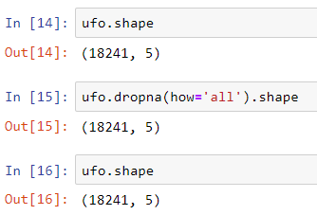
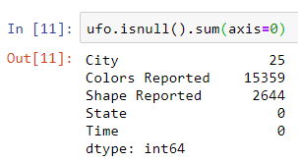
How do I handle missing values in pandas?
What we can do about the missing values….
I want to drop a row if all its values are missing.
State and Time has no missing value.
Notes:
ufo.shape
ufo.dropna(how='all').shape
ufo.shape

Slide 17

How do I handle missing values in pandas?
We can pass a number of columns to drop their rows if there is any missing value in them.
It means that I want to delete the rows that any of the values in ‘City’ and ‘Shape Reported’ columns are null.
Notes:
ufo.dropna(subset=['City','Shape Reported'], how='any').shape

Slide 18
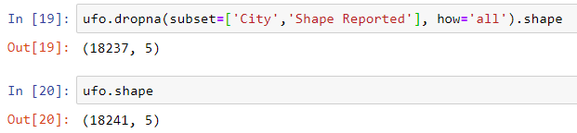
How do I handle missing values in pandas?
In this one we drop the rows that both values in ‘City’ and ‘Shape Reported’ columns are null.
There are only four rows that both ‘City’ and ‘Shape Reported’ values are missing.
Notes:
ufo.dropna(subset=['City','Shape Reported'], how='all').shape

Slide 19

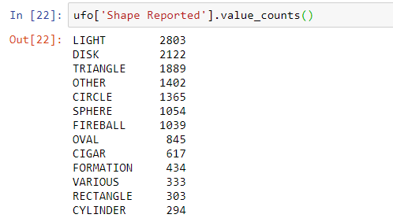
Bonus Tip
We want to fill some missing values….
It shows how many times a value is repeated in this column.
By default missing values are excluded.
Notes:
ufo['Shape Reported'].value_counts()

Slide 20
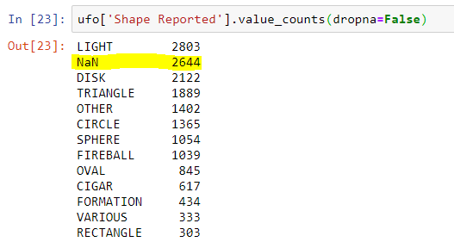
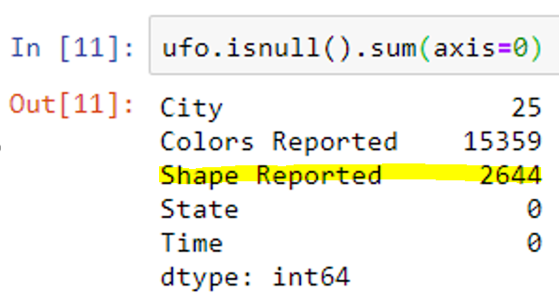
Bonus Tip
Including the missing values in our statistics…
Notes:
ufo['Shape Reported'].value_counts(dropna=False)

Slide 21
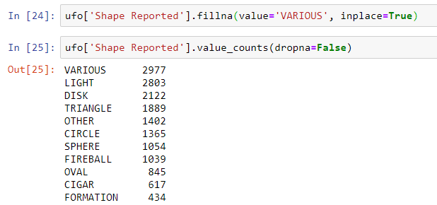
Bonus Tip
We have decided to fill the NaN values with ‘various’ as follows:
Notes:
ufo['Shape Reported'].fillna(value='VARIOUS', inplace=True)
ufo['Shape Reported'].value_counts(dropna=False)

Slide 22

Thank you
Question?
To be
Not to be

